Slide 1

CUSTOMIZED AI KITCHEN FOR INDIA
Team Members:
S.BHARATHRAJ - IV Year CSE (Cybersecurity) (Team Leader)
Team Mentor: – J.PRIYADHARSHINI (FACULTY OF CSE DEPARTMENT)
AVIT

Slide 2

Problem Statement
To Create an AI kitchen helper by using Intel's cutting-edge technology to improve cooking experiences with tailored recipe suggestions, live cooking tips, and automated pantry organization. The goal is for the solution to work well with smart kitchen appliances and use AI algorithms to adjust to user preferences, dietary restrictions, and ingredient availability. The ultimate aim is to make meal planning and preparation.
This statement describes the aim of developing a high-tech AI kitchen helper that not only aids in cooking but also enhances the overall culinary process by leveraging Intel's advanced technologies.

Slide 3

Unique breif solution
Empowers users of all skill levels to create restaurant-quality meals at home.
Saves time with efficient meal planning, grocery,shopping, and cooking processes.
Promotes healthier eating habits through personalized nutrition insights.
Supports sustainable living with eco-conscious cooking practices.

Slide 4

Features Offered
Here are some key features offered by Intel Unnati's customized AI kitchen solution:
Personalized Recipe Recommendations,
Real-Time Cooking Guidance,
Smart Inventory Management,
Meal Planning and Nutrition Tracking,
Voice and Gesture Control,
Community and Social Integration,
Environmental Sustainability,
Security and Privacy Assurance,
Integration with Smart Appliances,
Continuous Learning and Adaptation,
These features collectively enhance the cooking experience, making it more efficient, enjoyable, and aligned with individual preferences and dietary needs, while also promoting sustainability and community engagement within the kitchen environment.

Slide 5

Process flow
User Interaction:
Input: User interacts with the AI kitchen system through a mobile app, web interface, or voice commands.
AI Processing:
Input: User inputs and system data from IoT sensors and devices.
IoT Integration:
Input: Data from IoT-enabled kitchen appliances and sensors.
Data Management:
Input: User profile data, recipe database, and operational logs.
Output:
Output: System-generated outputs and user actions.
Activities:
Cooking Results: User receives notifications and visual feedback on cooking progress and completion.
Recipe Modifications: Users can adjust recipes based on personal preferences or ingredient availability.
Shopping Lists: Automated generation of shopping lists based on recipe requirements and inventory levels.
Feedback Loop:
Input: User feedback and system data.

Slide 6
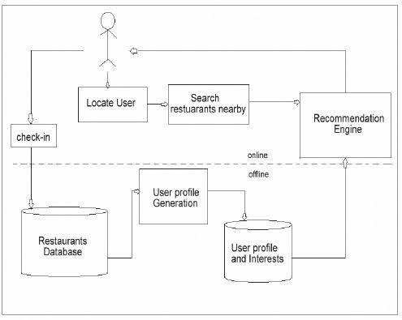
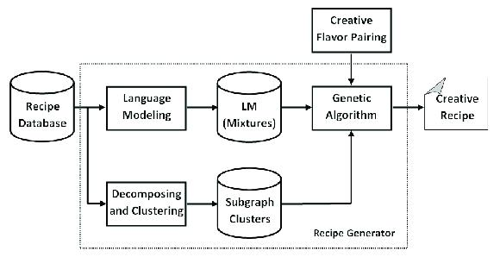
Architecture diagram

Slide 7


Technologies used
Front-end technologies:
1.User Interface (UI) Development : HTML5/CSS3,JavaScript:
2.Voice User Interface (VUI): Speech Recognition,Text-to-Speech (TTS)
3.Mobile Applications: React Native or Flutter
4.Security:Implementing secure communication protocols (HTTPS)
5.Augmented Reality (AR) (optional)
6.Accessibility:Following accessibility standards (WCAG) to ensure the front-end is usable by people with disabilities.
These technologies collectively enhance the usability, functionality, and interactivity of a customized AI kitchen, making it intuitive and efficient for users to interact with and manage their cooking processes.
Backend technologies:
Cloud Computing Platforms
Database Management Systems: SQL (e.g., MySQL, PostgreSQL) or NoSQL databases (e.g., MongoDB).
AI and Machine Learning Frameworks:TensorFlow, PyTorch, scikit-learn.
Server-side Programming Languages:Python Node.js

Slide 8
Conclusion
In conclusion, Intel's customized AI kitchen represents a convergence of innovation and practicality, empowering users to elevate their culinary skills, embrace healthier eating habits, and contribute to sustainable living—all while enjoying a seamless and personalized cooking experience. As technology continues to evolve, Intel remains at the forefront, shaping the future of home kitchens with intelligent solutions that blend cutting-edge technology with everyday practicality.
GITHUB LINK:https://github.com/bharathraj8608/CUSTOMIZED-AI-KITCHEN.git

Slide 9
Thank You

